Slide 1


Australian Road Fatalities
Scyne advisory
Data Insights & Recommendations
Noorullah khan

Slide 2
EXECUTIVE SUMMARY
Long-term trends show a remarkable decline in fatal crashes since the late 1980s, even as vehicle ownership and road usage have expanded significantly. However, improvements have slowed since 2020, with fatalities showing signs of rising again.
Demographic patterns reveal that males account for the vast majority of fatal crashes (~72%), while the 26–40 age group is the most overrepresented.
Environmental risk factors highlight that almost half of all fatal crashes occur on high-speed roads (100+ km/h), with urban low-speed zones (≤60 km/h) still contributing around one-third of fatalities.
Time-based analysis indicates weekends (Friday–Sunday), particularly late nights and early mornings, are strongly associated with higher fatal crash risk.
Machine learning insights confirm that hour of day, speed environment, and weekend driving are the most influential predictors of crash type, reinforcing the central role of behaviour and timing.

Slide 3




Aim & Hypotheses
Fatal crashes are more likely during weekends and late-night hours
Young male drivers are disproportionately involved in single-vehicle crashes.
High-speed roads see more single-vehicle crashes; multi-vehicle crashes cluster in commuting hours.
Weekend late-night + high-speed is the dominant recipe for single-vehicle fatalities across states.

Slide 4


Dataset overview

Slide 5
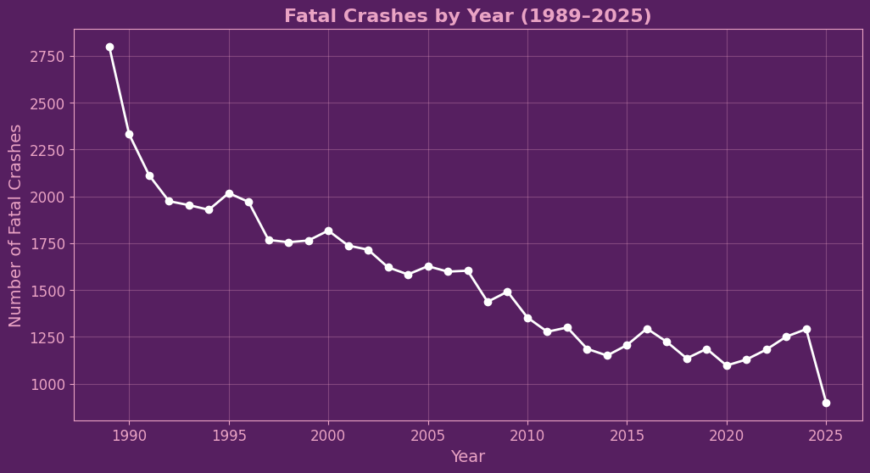
CRASH TRENDS OVER TIME
Fatal crashes declined sharply from late 1980s → mid-2010s.
Decline is remarkable given higher car ownership, more roads, and greater traffic volumes today.
Plateau since ~2020, with slight upward drift.
2025 dip is incomplete year effect (data still incoming).

Slide 6
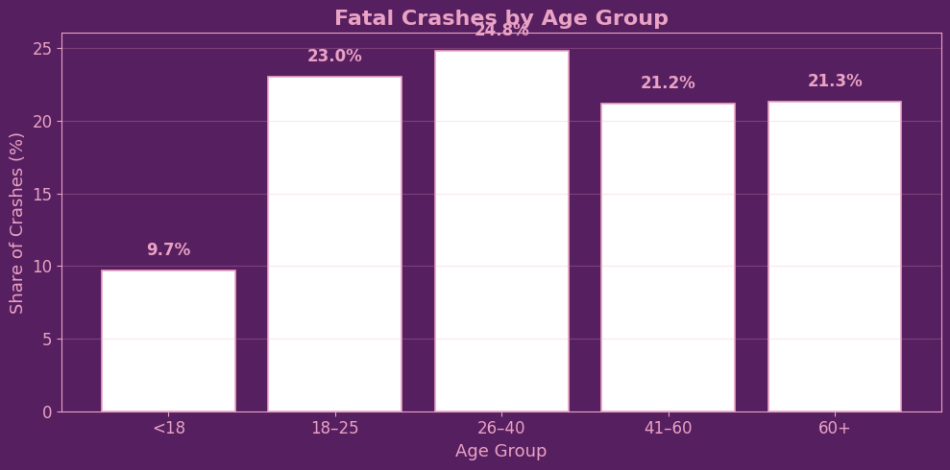
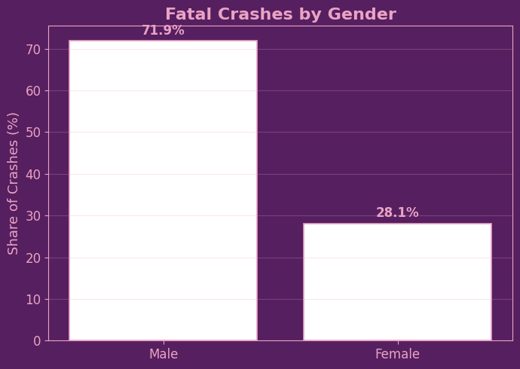
Fatal CRASH Demographics
Young adults (18–25) are heavily overrepresented given their share of the population.
Middle-aged drivers (26–40, 41–60) still contribute significantly, showing crashes aren’t only a “young driver problem.”
Gender imbalance: ~72% of fatal crashes involve male drivers vs ~28% female.
Elderly drivers (60+) show a increase, potentially due to fragility and slower reaction times.

Slide 7
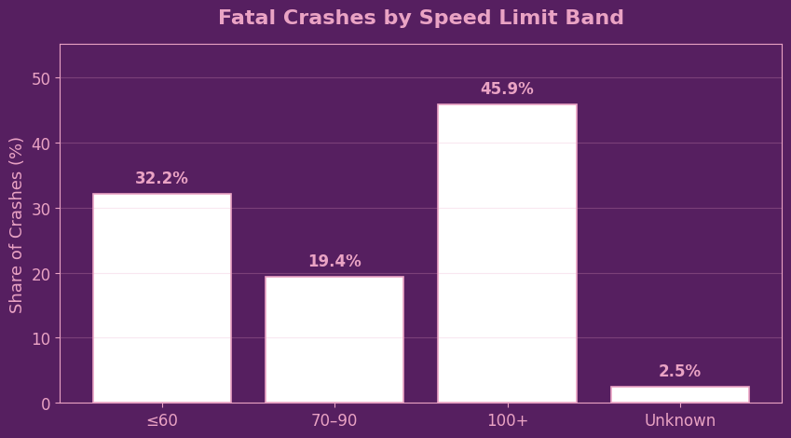
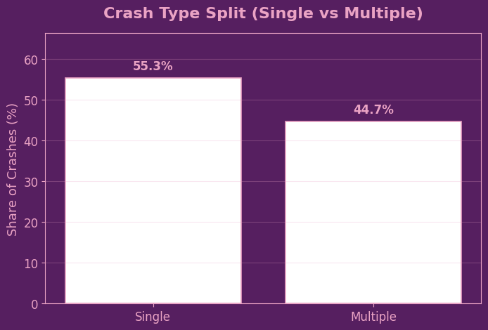
Fatal CRASH Demographics
Almost half of all fatal crashes (46%) occur on high-speed roads (100+).
Urban/commuter zones (≤60 km/h) still account for a large share (~32%), likely due to traffic density.
Single-vehicle crashes dominate (55%) → especially in high-speed or rural contexts.
Multi-vehicle crashes (45%) are still significant, concentrated in commuting/urban settings

Slide 8
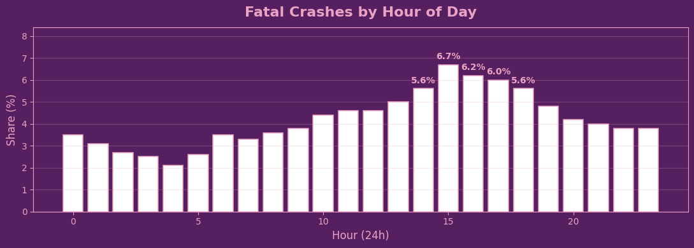
Temporal Patterns

Slide 9
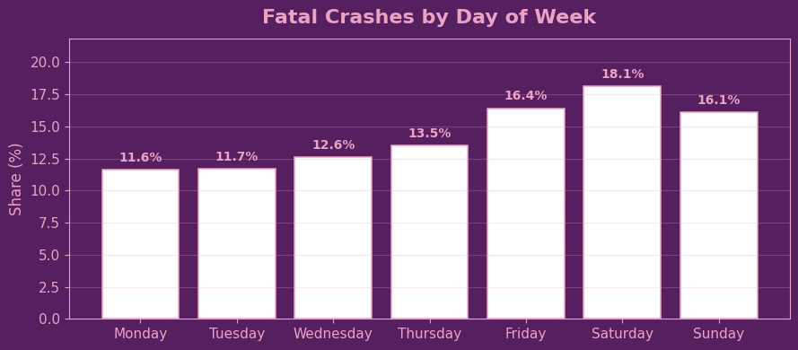
Temporal Patterns

Slide 10
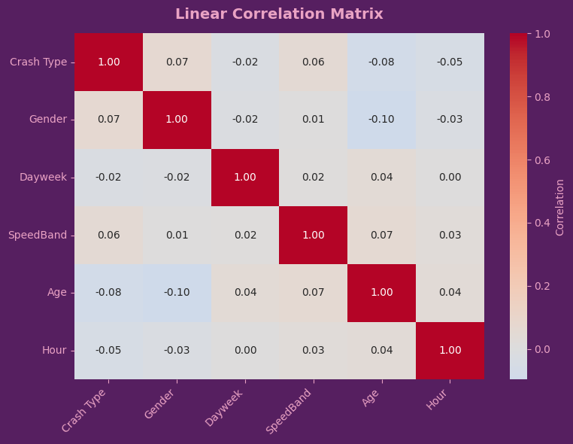
Linear relationships
LINEAR RELATIONSHIPS DON’T ALWAYS EXIST IN REAL WORLD DATA
SURFACE LEVEL ANALYSIS DOESN’T TELL THE WHOLE STORY

Slide 11
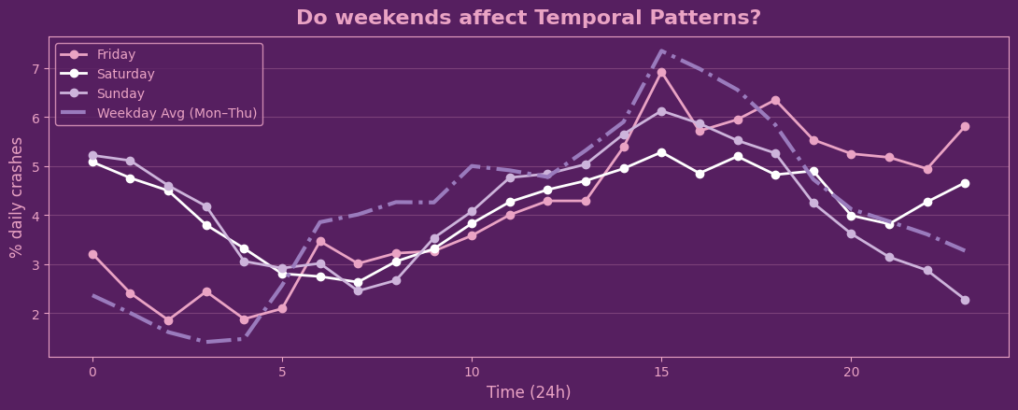
Deeper Temporal Patterns

Slide 12
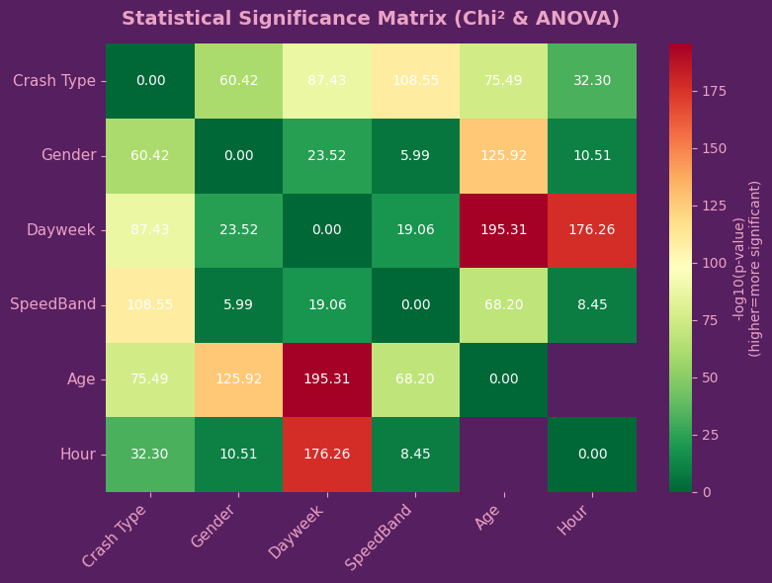
statistically significant relationships

Slide 13
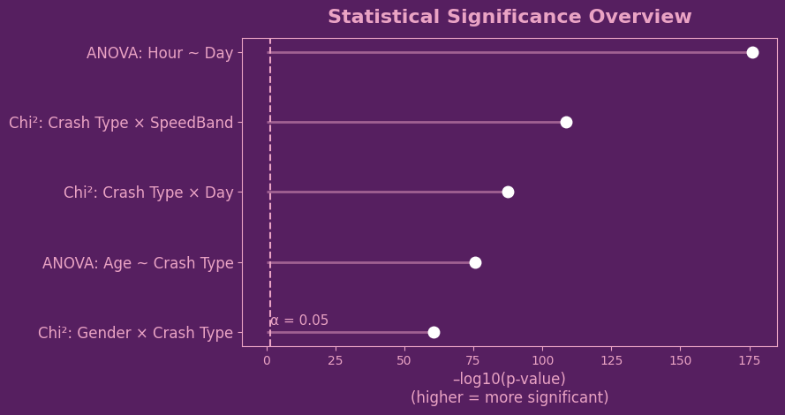
statistically significant relationships

Slide 14
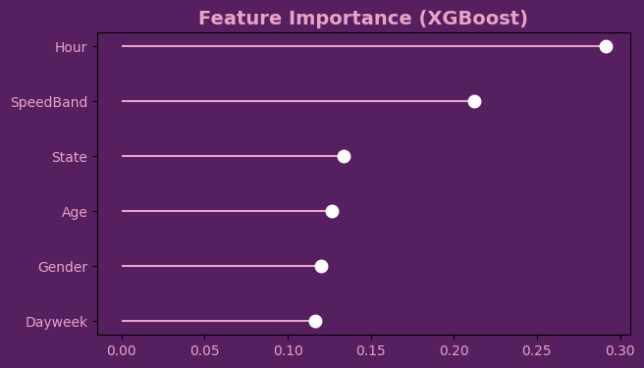
Machine learning
SHOWS SIMILAR FACTORS TO STATISTICAL TESTS

Slide 15
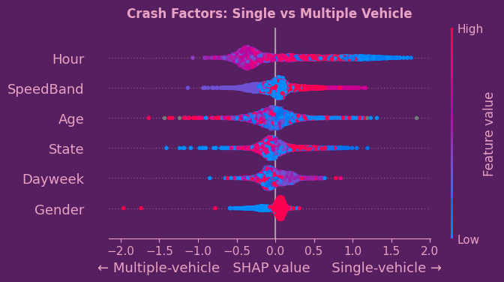
Single vs Multiple

Slide 16
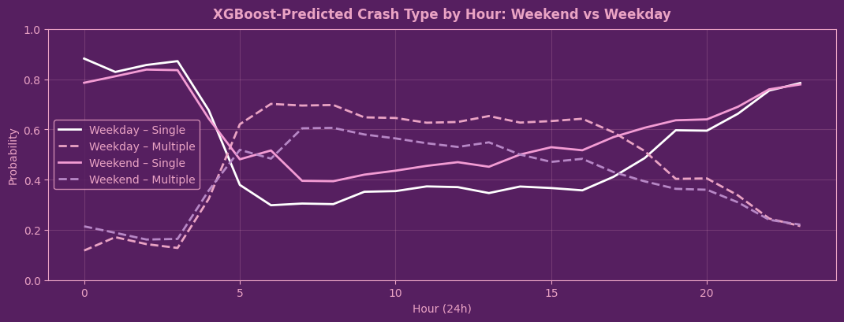
ML Predictions

Slide 17
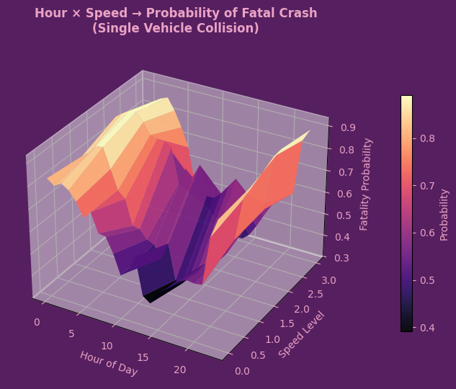
3d probability analysis
Are single crashes more likely at night on high-speed roads?

Slide 18
Findings & summary
Long-term improvement:
Fatal crashes have dropped sharply since the late 1980s, despite massive growth in car ownership and road networks.
However, progress has plateaued since ~2020, with fatalities trending slightly upward again.
Gender imbalance:
Males account for ~72% of fatal crashes, confirming a major risk factor.
Age risks:
26–40 year olds are most overrepresented in fatal crashes.
Young drivers (<18) form a smaller share, while risk rises again for 60+.
Speed environment:
Nearly half of fatal crashes occur in 100km/h+ zones.
Low-speed zones (≤60 km/h) still account for ~1/3, showing urban risk too.
Crash type:
Single-vehicle crashes (55%) slightly outnumber multiple-vehicle ones, highlighting driver behaviour and loss of control as key issues.
Time patterns:
Fatalities cluster heavily on weekends (Fri–Sun), especially at night and early morning.
Weekdays show flatter, steadier patterns.
Model insights:
Hour of day and Speed band are the strongest predictors of crash type.
Age also contributes but less strongly.

